Slide 1
Horizons in Physics Education: a network to improve the attraction of physics
Nadine Witkowski
Université Pierre et Marie Curie, Paris, France

Slide 2
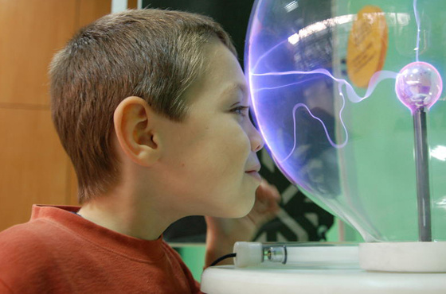
The objectives
Enhancing the impact of physics on the European economy
Collecting and sharing good practices in physics higher education
Providing recommendations
Providing recommendations

Slide 3
The priorities
WG1
Inspiring Young People to Study Physics
WG2
New Competences for Physics Graduates – Fostering Innovation and Entrepreneurship
WG3
Improvements in Physics Teaching – Meeting Future Global Challenges in Physics Higher Education
WG4
Improvements in the Training and Supply of Physics School Teachers

Slide 4
The project at glance
Academic network - LLP programme
Duration : Oct. 2013 – Sept. 2016
Coordinator : UPMC
Consortium
71 full partners
20 associated partners
31 LLP countries
5 third countries
Total budget : 1 128 434 €
EU grant : 598 634 €
Partners’ contribution : 474 300 €
Other sources : 55 500 €
4 Priorities

Slide 5
The network
71 partners in 31 LLP countries
65 academic partners (blue) incl. coordinators (red)
Large/small; research intensive/teacher training/PER
3 associations (EPS, Italian Phys. Soc., Int. Assoc. Phys. Students)
1 large facility (CERN)
2 companies (yellow)

Slide 6
Methodology
Elaborating questionnaires/ templates / protocoles
Disseminating and collecting data from partners
Analyzing and publishing results
Advicing on best practices

Slide 7
The network
20 associated partners incl.
8 universities in Europe (plus Russia)
USA: APS and 3 universities
Brazil: Sao Paulo University
India: Museum of Science, Hyderabad
Universities in Europe
IBM Zurich
Romania: National Institute of Physics and Nuclear Engineering
GIREP, UK’s IOP
Argentina: Physics Teachers Association

Slide 8
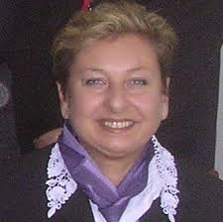
Coordinators
Nadine Witkowski
General management
Aurora
Sanseverino
General manager
Université Pierre et Marie Curie
Marisa Michelini
Scientific management
WG1 / WG4
Università degli Studi di Udine
Ivan Ruddock
Scientific management
WG2/ WG3
Strathclyde University

Slide 9
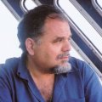
Advisory board
Urbaan M. Titulaer
Johannes Kepler Universität
Evangelos G. Vitoratos
University of Patras
Jan Naudts
Universiteit Antwerpen
Hendrik Ferdinande
Universiteit Gent
Gareth Jones
Imperial College London

Slide 10
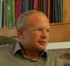
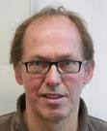
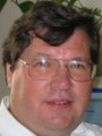
Working groups
WG1
Trippenbach Marek
Madalin Bunoiu
WG2
Hay Geurts
Jos Rogiers
WG3
Eamonn Cunningham
Fernando Cornet
WG4
University of Warsaw
West University of Timisoara
Radboud University Nijmegen
Katholieke Universiteit Leuven
Dublin City University
Universidad de Granada
Mathelitsch Leopold
Karl-Franzens-Universitaet Graz
Mohoric Ales
University of Ljubljana

Slide 11
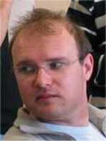
Working groups
WG1
Trippenbach Marek
Madalin Bunoiu
WG2
Hay Geurts
Jos Rogiers
WG3
Eamonn Cunningham
Fernando Cornet
WG4
University of Warsaw
West University of Timisoara
Radboud University Nijmegen
Katholieke Universiteit Leuven
Dublin City University
Universidy of Granada
Mathelitsch Leopold
Karl-Franzens-Universitaet Graz
Mohoric Ales
University of Ljubljana
Elzbieta Stephan
University of Silesia

Slide 12
WG1 : Inspiring Young People to Study Physics
“To investigate and report on the factors that influence young people to study physics”
2 meetings : Warsaw, Naples
Preliminary results presented in Helsinki forum
Instruments developed
Questionnaires for first year university students
Interviews for first year university students
Template for student competitions
Template for good practices in School-University
Questionnaire for secondary school students
Data being collected from the partners
Data being analysed by the partners

Slide 13
WG1 : Inspiring Young People to Study Physics
Pré-questionnaire distribué lors des inscriptions pédagogiques en juin 2014
64 questionnaires papier recueillis (40% de fille)
Questions sur les facteurs notée entre 1 (pas d’influence) à 5 (beaucoup d’influence)

Slide 14
WG1 : Inspiring Young People to Study Physics
Age auquel ils ont vraiment ressenti un intérêt pour la physique : 14 (G) -16(F) ans

Slide 15
WG2 : New Competences for Physics Graduates – Fostering Innovation and Entrepreneurship
“To recommend ways by which physics degrees can be enhanced so that graduates can contribute more effectively to new needs of the European economy and society, particularly through innovation and entrepreneurship.”
2 meetings : Lille (2014), Hannover (2015)
Instruments developed
Questionnaire for alumni and employers
Questionnaire for institutions
Data collected
Data being analysed by the partners
Results to be presented during Coimbra forum (9 -12 september 2015)

Slide 16
WG3 : Improvements in Physics Teaching – Meeting Future Global Challenges in Physics Higher Education
“To improve the effectiveness and attractiveness of physics teaching in Europe’s university physics departments to help ensure their competitiveness in the global student market.”
2 meetings : Dublin (2014), Granada (2015)
Instruments developed
Questionnaire for institutions on mobility
Template for data collection on innovative teaching methods
Data being collected
Results to be presented during Coimbra forum (9 -12 september 2015)
iStockphoto.com/Andrew Johnson

Slide 17
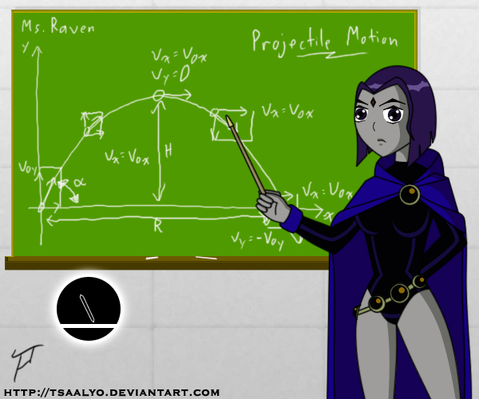
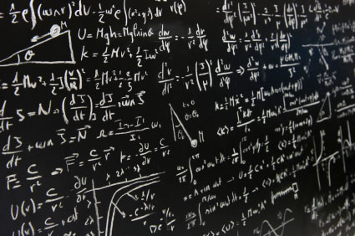
WG4 : Improvements in the Training and Supply of Physics School Teachers
“To recommend strategies for increasing the supply of well-trained physics school teachers and to enhance the role of university physics departments in helping the teaching of physics in schools.”
First meeting in Zagreb 18 – 20 june 2015
Shortage of physics teacher
Pre-service training
In-service training

Slide 18
Methodology
WG1
WG Meeting
Warsaw
January 2014
WG Meeting
Naples
May 2014
WG2
WG Meeting
Lille
April 2014
Forum
Coimbra
9-12 Sept. 2015
WG3
WG Meeting
Dublin
November 2014
Forum
Coimbra
9-12 Sept. 2015
WG4
WG Meeting
Zagreb
21-23 June 2015
Forum
Bucharest
September 2016
Forum
Helsinki
August 2014
WG Meeting
Hannover
April 2015
WG Meeting
Granada
7-9 May 2015
WG Meeting
Riga
Nov. 2015

Slide 19
Keep informed on HOPE network
www.hopenetwork.eu
Contribute to the network : nadine.witkowski@upmc.fr
Participate to forum :
Coimbra 9-12 september 2015
Newsletters
Progress/results about the network activities/ related events
Next: july 2015

